Slide 1



EXHIBITOR BRIEFING
VIV AFRICA 2026
14 July 2026

Slide 2

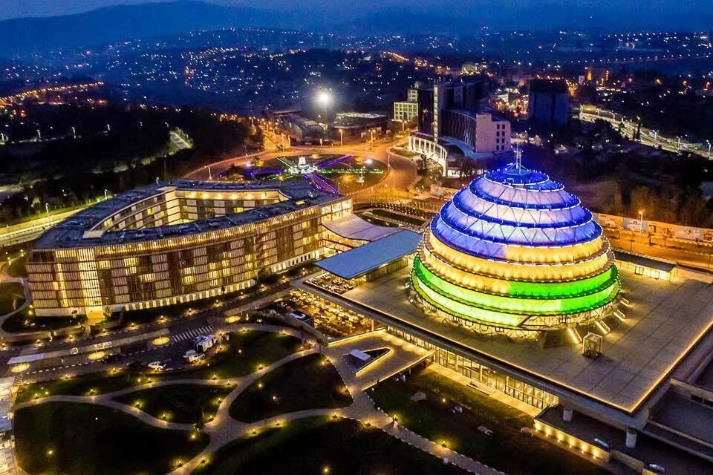
Contents
Operations teams & disclaimer
Exhibitor portal & VISIT CONNECT
Our partners
4. Important deadlines
5. Stand construction & approval
6. Construction, show, dismantling
7. Sponsor items (CMO)

Slide 3

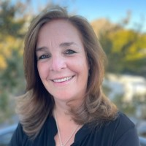
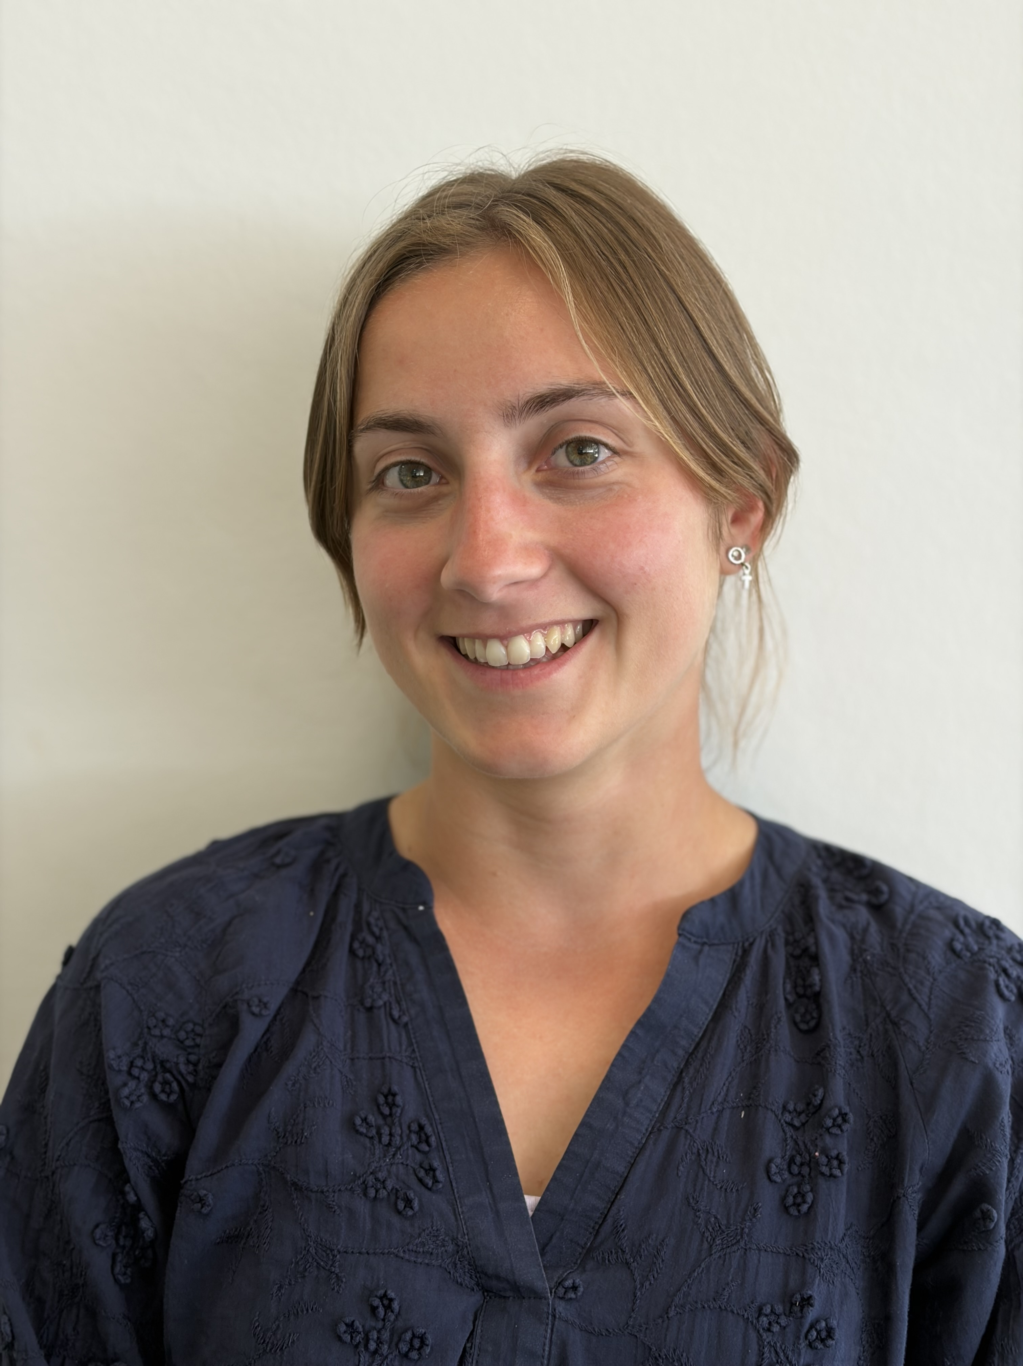
1. Operations team VNU & disclaimer
Mirjam Govaerts
mirjam@vnueurope.com
&
Marie Leger
marie@vnueurope.com
Overall operations management and your point of contact for all your questions regarding the Exhibitor Portal, sponsor items, stand construction, etc.
!DISCLAIMER!
This briefing does not exempt you from going through the Exhibitor Portal. The information in the Exhibitor Portal is kept up to date, while this presentation is not. The information in the Exhibitor Portal is therefore always leading.

Slide 4
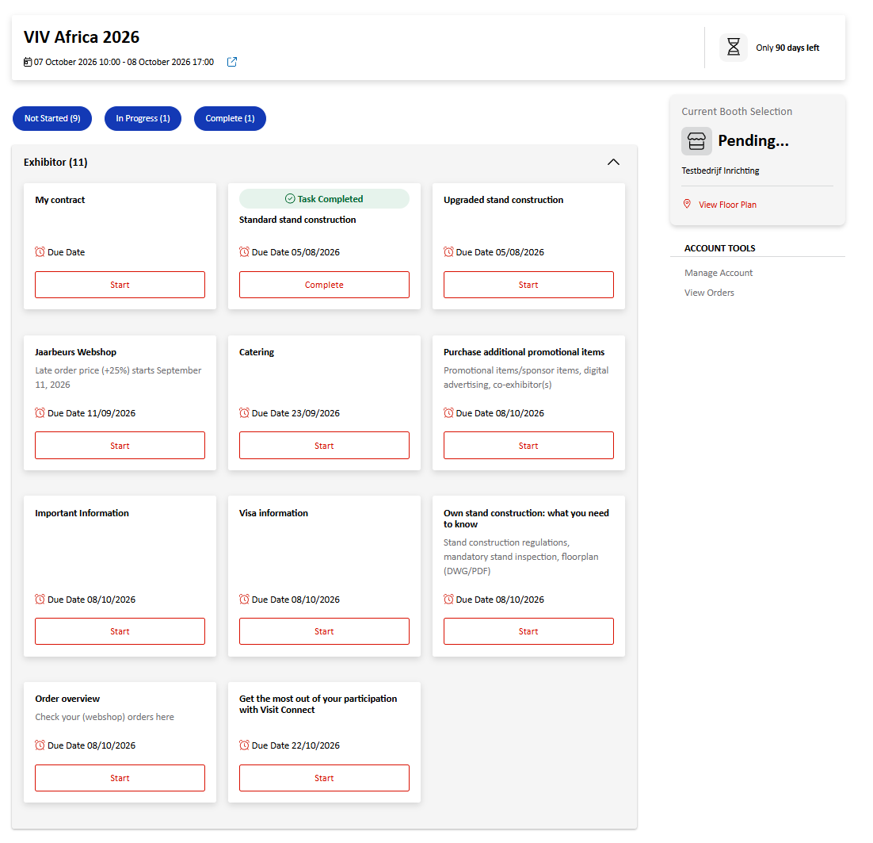
2. Exhibitor Portal
All the information you need to prepare for your participation, are divided over different tasks. Tasks are sorted on deadline and whether you started them or not. To display all tasks, select all three buttons at the top of the screen (Not Started, In Progress, Complete).

Slide 5
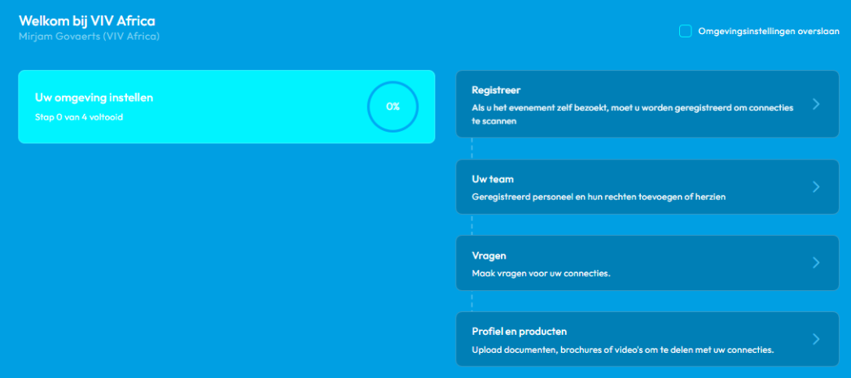
2. Exhibitor portal
Get the most out of your participation with VISIT CONNECT
With the new event app Visit Connect, you'll get more out of your trade show participation. The app helps you increase your visibility, strengthen your network, and gather valuable leads - before, during, and after the event. Whether it's completing your company profile, inviting contacts, or collecting leads: Visit Connect supports you every step of the way. In this guide, you'll discover all the app features and how to get started right away.
➡️ Ms Cherise Brand from our Exhibitor Activation team will walk us through the app and its key features.

Slide 6
2. Exhibitor Portal
Additional orders
Can be accessed through the Exhibitor Portal in the task: “Jaarbeurs Webshop” Here you can order TV monitors, additional furniture, electrical sockets etc.
Prices increase on 11 September 2026
Webshop closes on 18 September 2026
ORDERS ARE ONLY FINAL AFTER COMPLETING THE PAYMENT!

Slide 7
3. Our partners
Partners | Service
Events Factory | Standard and Upgraded stand construction plus grahics design
KCC (Kigali Convention Centre) | Catering, electricity for raw space and extra internet
GKL Showfreight B.V. - The Netherlands | International freight forwarding
Event & Media (EMS) | Hostess

Slide 8
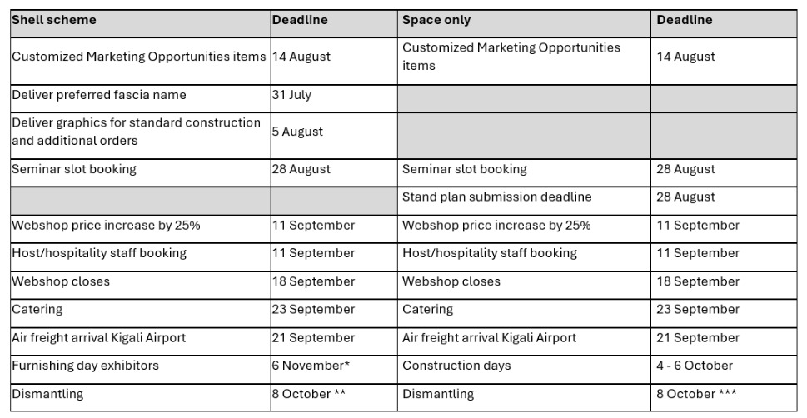
4. Important deadlines
Between 15:00 – 18:00 hrs
From 17:00 - 18:00 hrs, exhibitors must remove all items from their stand
From 18:00 – 22:00 hrs dismantling for raw space stands
Notes:
CMO items

Slide 9
5. Stand construction & approval
Standard stand construction
Check what is included in the Exhibitor portal,
Submit your preferred company name for the fascia in the space provided before 31 July 2026,
Please note that graphics are not included.
Upgraded stand construction
Check what is included in the Exhibitor portal,
Submit your preferred company name and the colour for the fascia in the space provided before 31 July 2026,
Send your graphics to Rogers Mawange from Events factory (exhibition@eventsfactory.rw) before 5 August 2026.
Raw space / own stand construction
Own stand constructions must submit their stand design to Annemieke.timmers@jaarbeurs.nl) before 28 August 2026. Please review the Stand Construction Rules and Regulations in the Exhibitor Portal task: "Own stand construction: what you need to know".
In the same task you
Find the list of recommended stand contractors
Find the compulsory forms (Method statement form)

Slide 10
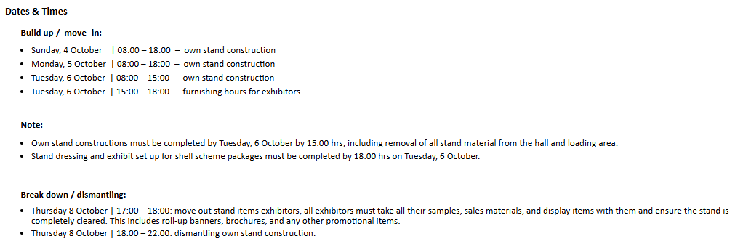
6. Construction, show and dismantling

Slide 11
7. Sponsor items (CMO)
Boost your business by investing in unique marketing opportunities
Mix digital and onsite promotions before, during or after the show. For example:
Capture attention with a featured news article showcased on the VIV AFRICA website.
Guide visitors to your booth with attractive advertisement in the Show Guide.
Maximize visibility with teardrop flags in front of the entrance and striking charging station in the lobby of the venue.
Want to know more?
VIV AFRICA 2026 – CMO Brochure (to be found in the task “Purchase additional promotional items” of the exhibitor portal.
Contact Rachel Lum (rachel@vnueurope.com) to book promotional items.

Slide 12
9. Questions
Q1: Where can we eat during the exhibition?
A1: You can order stand catering from KCC (contact details to be found in the Exhibitor Portal (deadline to order is 23 Augustus 2026). Besides that, there will be a couple of take-away inside the venue (but not inside the exhibition hall), as well as the Filini restaurant.
Q2: What is the process for adding graphics to your Upgraded stand construction?
A2:Firstly, please confirm how many graphics you would like to include and how many will fit within your stand space. You can contact Marie Leger (marie@vnueurope.com) for assistance in determining the best layout and requirements.
Once the graphics have been prepared, please send them to Mr Rogers Mawanga (exhibitions@eventsfactory.rw) as print-ready PDF files at 300 dpi via WeTransfer. He will review the designs and create a mock-up of the booth for your approval.
The deadline for submitting the graphics is 5 August 2028.
Please not that the Standard stand construction does not include graphics!

Slide 13
8. Questions
Q3: What about sponsor items?
A3: A selection of sponsor items is available in the Exhibitor Portal under the task “Purchase additional sponsoring items”. Additional options, including exclusive onsite opportunities, will be listed in the Sponsor Items Brochure. Please contact Rachel Lum at rachel@vnueurope.com for more information.
Q4: Where can I find the slides and recording of the exhibitor briefing?
A4: You will be able to find both the slides and the recording on the VIV Africa website under the Preparation/Exhibitor portal section. These will be available one week the exhibitor briefing.
Q5: I have a question about invoices?
A5: Please contact with Rachel Lum at Rachel@vnueurope.com for any invoice-related questions.
Any other questions remaining, please contact mirjam@vnueurope.com

Slide 14

Thank you for your attention

